Slide 1
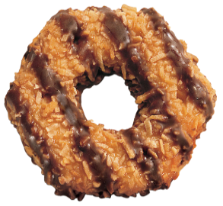
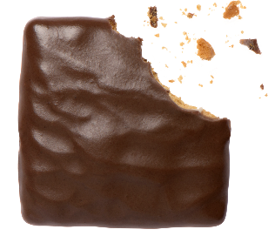
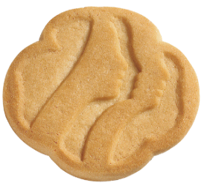
2017 GIRL SCOUT COOKIE PROGRAM
January 7 – March 26
TROOP TRAINING

Slide 2
Initial: Jan. 7 – Feb. 3
Online: Jan. 1 – March 26
Keep Goaling to reaching the troop reward 300: Feb. 4 – March 26
Booth Sales: Feb. 25 – March 26
Payments: #1 March 6th
#2 March 29th
Timeline
ORDER
TAKING
Jan. 7
DIRECT SELLING
Feb. 25
DIGITAL
Opens Jan 1
Order Cards
Digital Platform (Promise)
Initial Order
Feb 5th
GSWNY Lottery
Jan 16-28
FCFS Avail Feb 1
Webster SU
Feb 7th
COCOmobile
COCOdirect
FB link
The Online program starts early to allow girls & parents to set up girls dashboard, send emails and market on Social Media.
Notes:
*How do we sell cookies?
Today’s girls are on the move, and we want to support their sales efforts in a variety of ways. How do girls sell today?
Order taking – in an order taking sale, the sale starts with girls and their order cards hitting the streets and collecting orders. But even in a direct sale, order taking has a role! If a girl is currently out of one variety, she can continue to sell and take orders to be filled at a later date for the other cookies. Or she may follow up 10–12 days after the start of the sale and take orders for additional cookies as her customers may have eaten their first purchase!
Online marketing – in addition to using the order card to collect orders, girls can expand their customer base by using the online marketing tools. Girls can send eCards to their regular customers to collect orders and spend more “boots on the pavement” time finding new customers. She can also use the online cards to contact folks in the case of inclement weather! The online marketing option also has a COCOdirect experience – more about that in a minute.
Direct sales – direct sales are different than booth sales. Direct sales really refer to a single transaction – the girl has cookies in hand, she sells to the customer, and collects money all in one step. Direct sales can be door to door like order taking, or it can be special event based sales like cookie caravans, where a troop goes to a new, untapped neighborhood, or cookies and milk breaks at a local business.
Booth sales – traditionally held outside grocery and other retail markets, this segment of the sale continues to be popular. We’ll get into more detail on our booth programs later in training, but we need to think outside the “cookie booth box.” What about a drive-through booth or setting up a booth at a food truck festival or other community event?
COCOmobile – this easy to use free app, available on both the iPhone and Android platforms, is a digital order card. Instead of a paper card, girls enter their order and customers get an email confirmation of their order! Girl delivery is still necessary through the traditional COCOmobile. Girls who took their orders last year on the mobile app sold an average of seven more boxes per girl – a great way to boost sales!
And introducing our newest sales method – COCOdirect. This is a direct-to-consumer order process where the girl either sends out an eCard through COCO online, or takes an order for COCOdirect through the mobile app. The customer orders, pays for, and receives the cookies with money collection or delivery by the girl. We have more details later in this presentation.

Slide 3
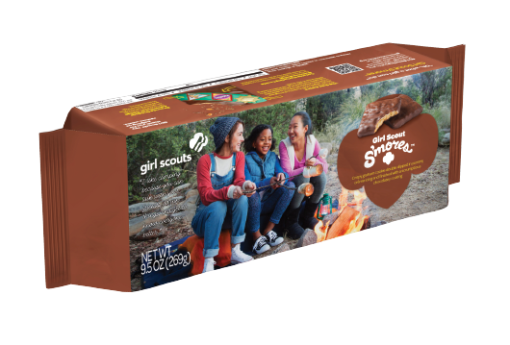
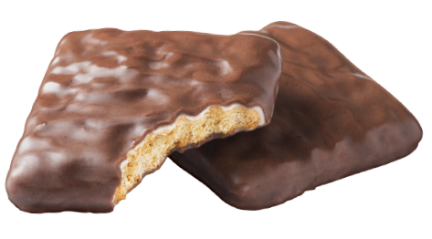
Product Highlights
Vegan
Kosher
Nut free
0 Trans Fat Per Serving
No Artificial Colors
No Preservatives
Made with Real Cocoa

Slide 5
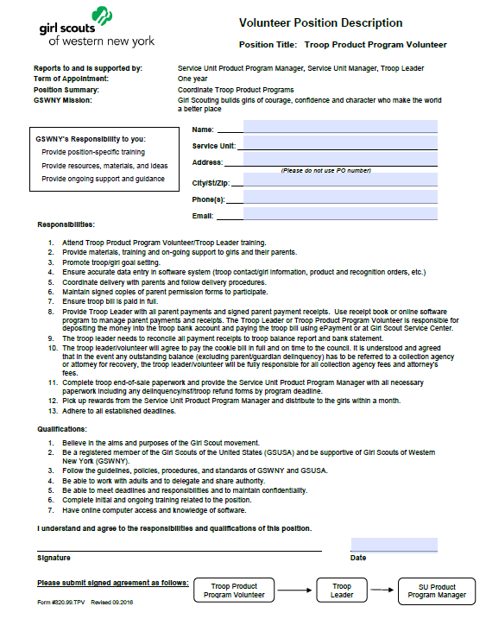
Troop Product Program Manager Volunteer Position
Review Responsibilities
Review Process
Notes:
Troop Product Program Manager Volunteer Position Description….Review Responsibilities and process

Slide 6
EARN THIS SPECIAL PATCH TO CELEBRATE
100 YEARS OF SELLING GS COOKIES!
Notes:
Goals: Girl, Troop, 100 patch

Slide 7
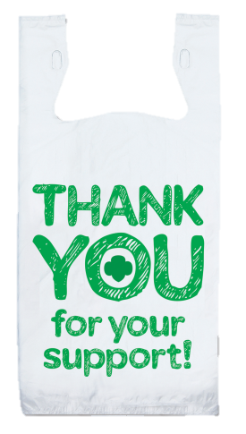
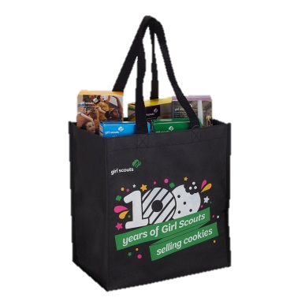
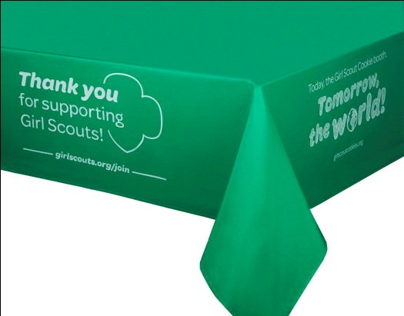
Bling Your Booth Cookie Kit $25.00
Available for purchase in the Girl Scout Shop!
The kit includes: a fabric tablecloth, a large cookie display box, a rollbanna, and 50-plastic Thank you bags all packaged in a tote.
Please visit the Girl Scout Shop for lots more Cookie merchandise and patches.

Slide 8
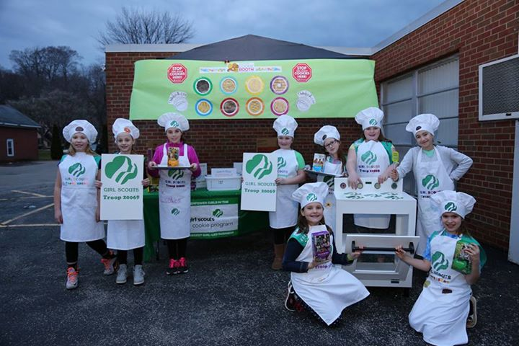
Remind Troops to Order Troop BOOTH SALE COOKIES with Their Initial Cookie Order
Orders must be placed by Sunday midnight for same week pick-up
Planned orders are due in Snap+ Sundays, Feb. 26, March 5, 12, 19
Visit http://www.gswny.org (cookies+ tab) for cupboard locations/times. No walk-ins allowed
Product is delivered to cupboards on Fridays.
Use the Booth Scheduler (Snap+)
View Booths by Date
Request Lottery or Booth Location

Slide 9
Step-by-Step YouTube Trainings and Webinars
www.gswny.org (Select Cookies+ Tab)
YouTube Trainings
Update Troop Info
Girl Information/Sizes
Product/Rewards Orders
Delivery Time
Planned Orders
Booth Scheduler
Reports
Webinars:
Jan. 18: Snap+ Navigation, Program Resources
Jan. 25: Booth/Direct Sales
March 22: End-of-Sale Steps, ePayment

Slide 10
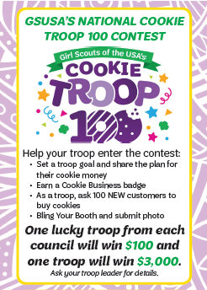
Just 4 Easy Steps
.
.
.
.
https://www.youtube.com/watch?v=Kbp_irYtHe4&feature=youtu.be
Notes:
Cookie Troop 100

Slide 11
Benefits for Troops & Girls
Troops Earn Proceeds to Support Programs
$.63 per package
$.68 per package (Cad/Sr/Amb. option)
Troop Experience Reward
When the troop averages 300 boxes per girl by March 26, all participating girls who sold in the troop and two adults will receive receive a WonderZones pass to WonderWorks (excluding ropes course) along with t-shirt, mug, and etote.
Benefits for Troop
Troop Incentive
When the troop averages 160 boxes per girl and all on time, the troop payments (both initial and final) are paid troop receives $25.

Slide 12
NEW S’mores Cookie
Project Share
Cookies are paid for at the time of the order and shipped directly from warehouse to military.
NEW THIS YEAR: Customers may purchase Project Share cookies online ($1.25 processing fee per order)
$4 per package
$5 per Gluten-Free
Money is collected when product is delivered.

Slide 13
Snap+ Sign On

Slide 14
Cookie Sheet– Main Page

Slide 15
Bottom half of Cookie Sheet

Slide 16
Troop Drop Down Box
Notes:
Editing Troop/Girl Information
Main Menu/My Troop
Click Troop Girls or Edit Troop Information

Slide 17
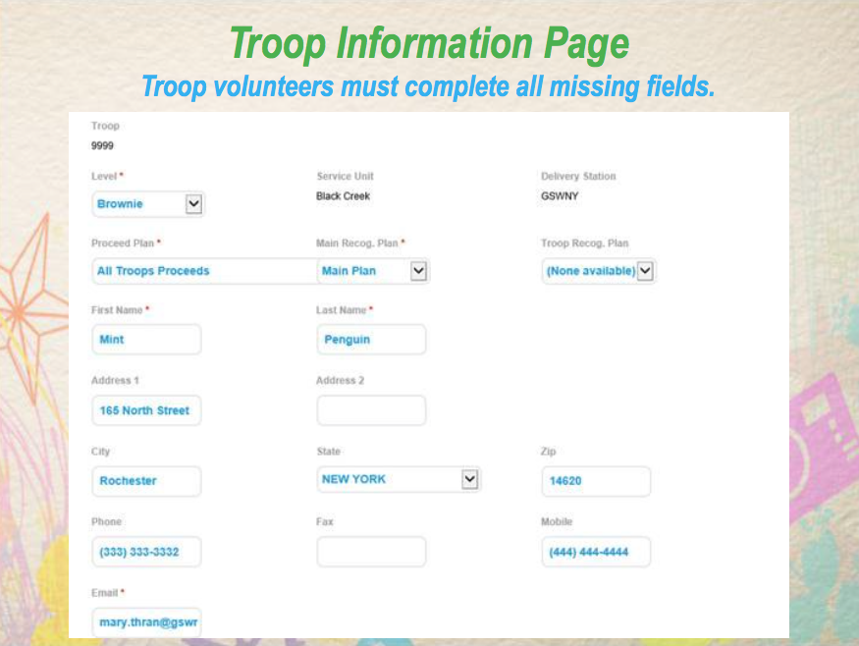
Notes:
Please make sure all areas are completed.
It is VERY helpful for your address and phone contacts be completed and up to date

Slide 18
Edit Troop Girls
Notes:
Edit Girl Info
You can delete a girl/duplicates by clicking the red X
Confirm you want to delete
You can edit a girls information by double clicking her name
***This is where you put in their sweatshirt size***
To Add a New Girl
Click the Add New Girl Button

Slide 19
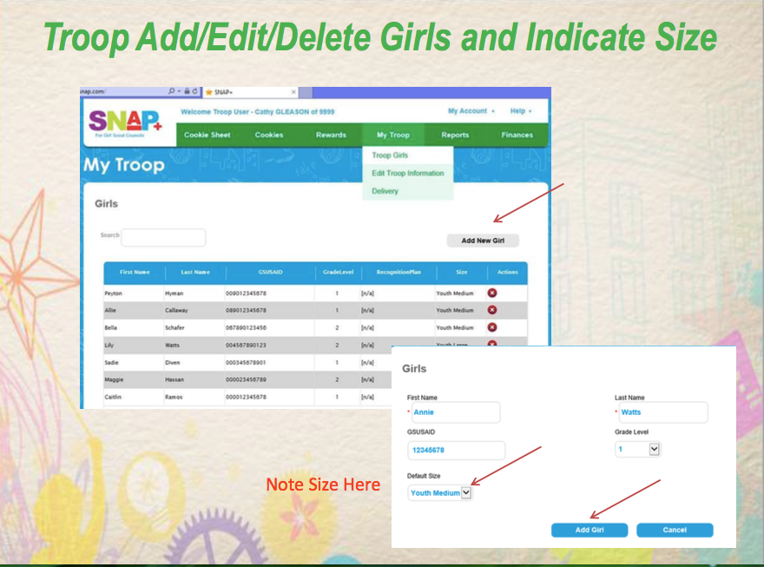
Notes:
Adding New Girl or Changing Information
Click Add Girl/Save
Confirm

Slide 20
Add a new girl
Notes:
You only HAVE to complete the red star sections.
Though Grade Level and Shirt Size is VERY helpful to complete now

