Slide 1
Snap+ Sign On

Slide 2
Cookie Sheet– Main Page

Slide 3
Bottom half of Cookie Sheet

Slide 4
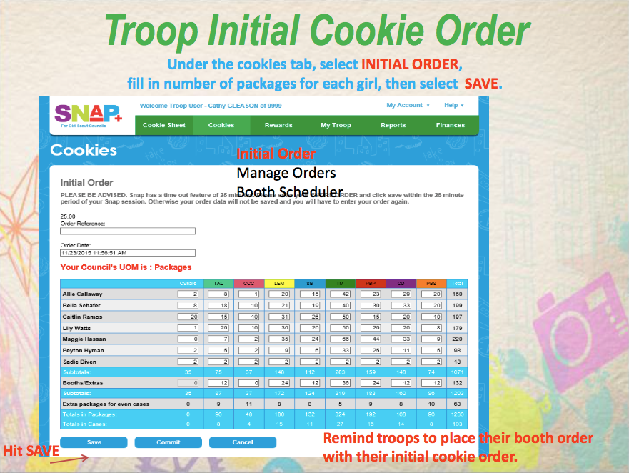
Notes:
Cookies Tab at top menu
Click Initial Order
THIS SCREEN Unit of Measure is PACKAGES
Put in each girls order (in packages)
You will see that you Extra packages to make even cases completes itself. Cookie Delivery is only cases the SNAP system does it for you.
Put in your Booth/Extras wanted. This is in 12 package increments(full cases)
Hit SAVE
Answer YES/CONFIRM

Slide 5
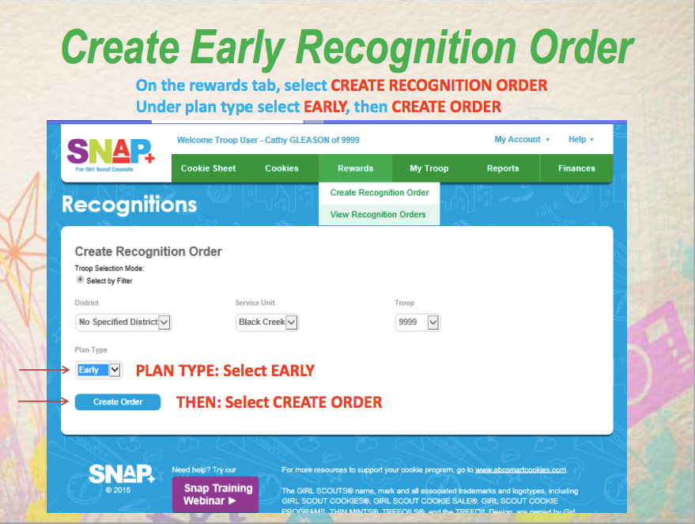
Notes:
Rewards on Menu Bar
Click Create Recognition Order
Plan Type is EARLY
Click Create Order

Slide 6
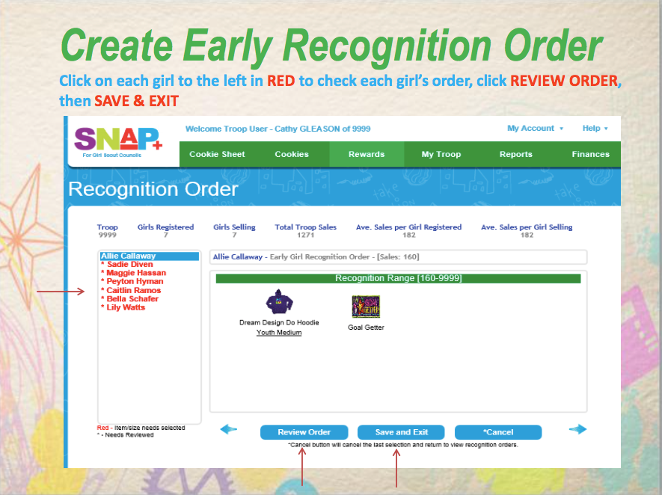
Notes:
All Names of registered girls will be in red
You will need to click through all before reviewing then saving order
Even the girls that do not reach the early goal
It is a good idea to get ALL girls shirt/sweatshirt sizes early
I also have the girls tell me their prizes choices early too… I ask them to circle on their rewards sheet/copy of the rewards sheet all the way up through gift cards when they return their initial numbers.
Review Order
Confirm
Save and Exit
Confirm

Slide 7
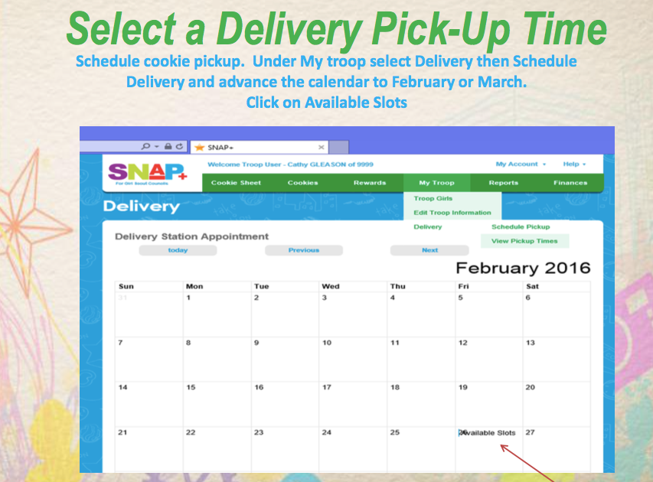
Notes:
Menu Tab-My Troop
Find the correct month
Cookie Delivery is currently scheduled for February 23(Thursday) thru February 25 (Saturday)
This does occur at the end of Websters February Recess.
Click on the day you wish to schedule

Slide 8
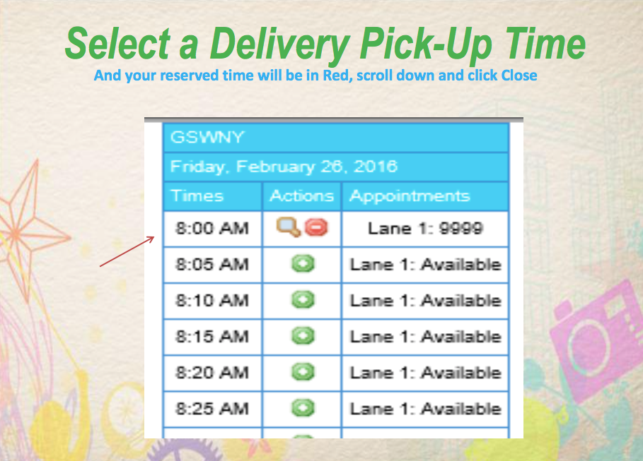
Notes:
Choose the time you wish to pick up(green plus)
Remember you will need 2 people(no person under 16 can help)
One will stay in the car(drive through cookie station)
One will count and supervise the cookies placed into the vehicle
If there is a multiple car need there only needs to be 1 cookie counter

Slide 9
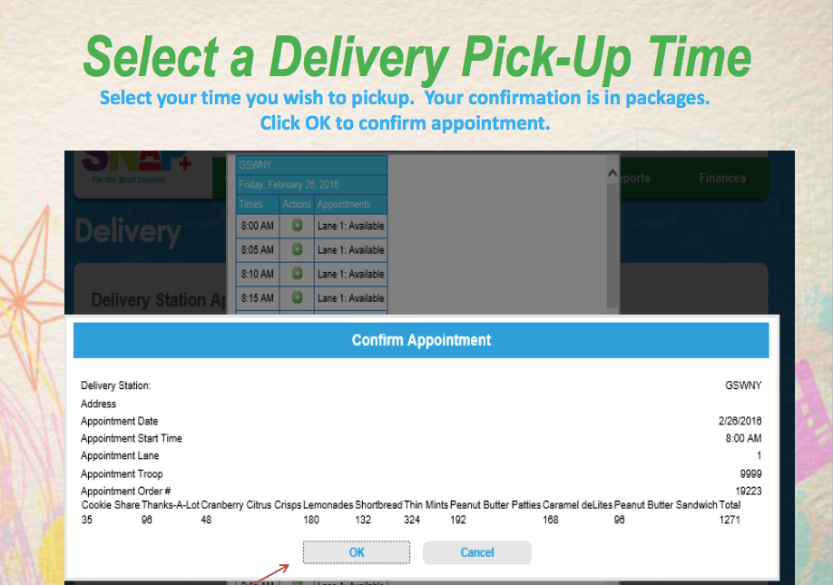
Notes:
Confirm your appointment

Slide 10
Notes:
Council Sponsored Booth Lottery is January 16th – January 28th
It is not a first come/first serve
You can choose up to 5 and everyone will be notified on January 29th which one your troop wins.
First come/first serve opens up February 1st
This is where you can pick up as many as you want open council sponsored booth slots

Slide 11
Cookie Sheet– Main Page
Notes:
Main Menu – Cookies
Click Booth Scheduler
Click Schedule a Booth or Lottery Request

Slide 12
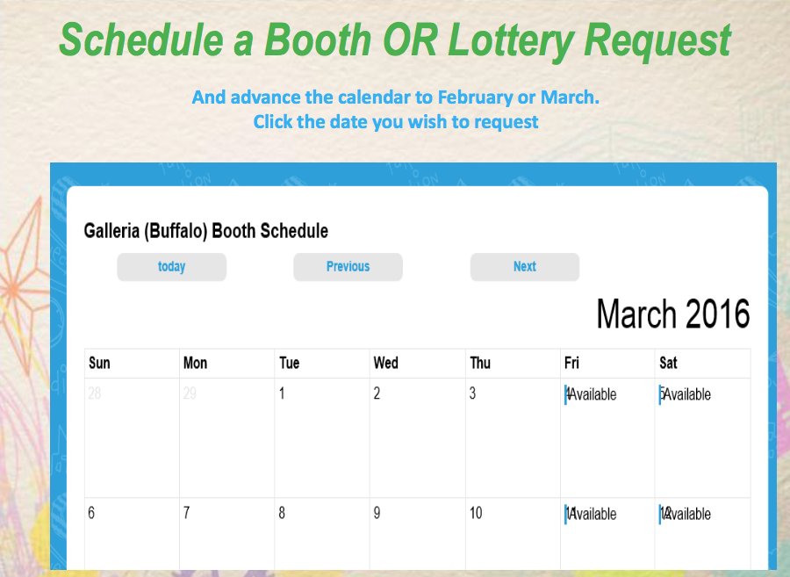
Notes:
Click the date you wish to put in a request for

Slide 13
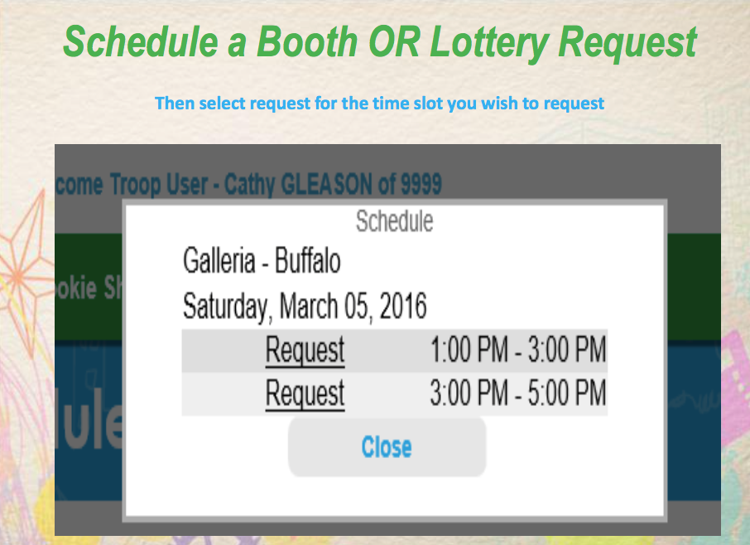
Notes:
Click Request for the time slot you want

Slide 14
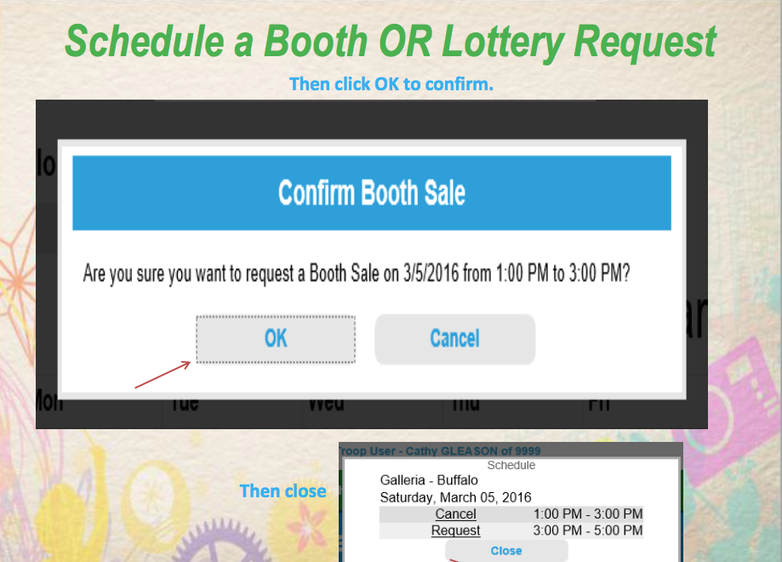
Notes:
Click:OK to confirm

